Slide 1
Team Auto_Fail 💥
Hojin P, Bilal M, Winston W, Karl P

Slide 2
Case 2: Pick and Place Anomaly Detection
Where we were
Where we are
Where we will be

Slide 3
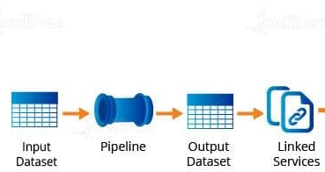
Factory Pipeline Process :
Raw data
(Json file)
Our initial goal

Slide 4
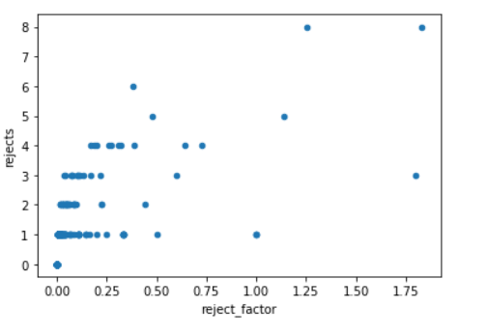
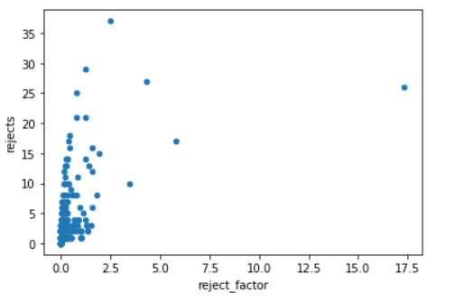
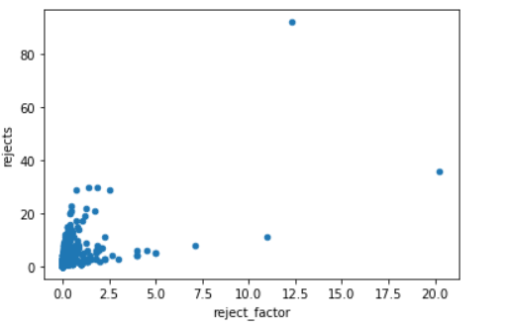
Data Analysis:
500s test data
2000s test data
5000s test data

Slide 5
Detected Anomaly Cases:
When picks are lower than placements
When rejection occurs higher than 20% (reject_factor > 0.2)
When there are more than 4 successive rejects.

Slide 6
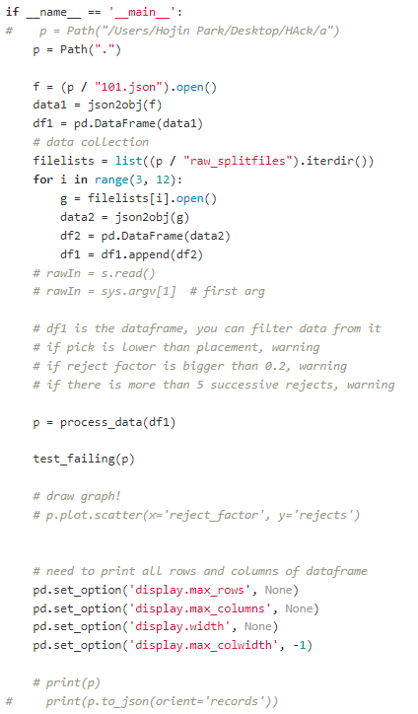
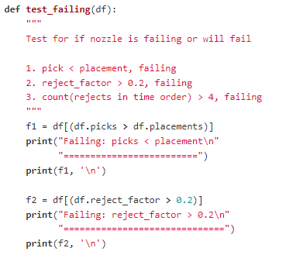
Implementation

Slide 7
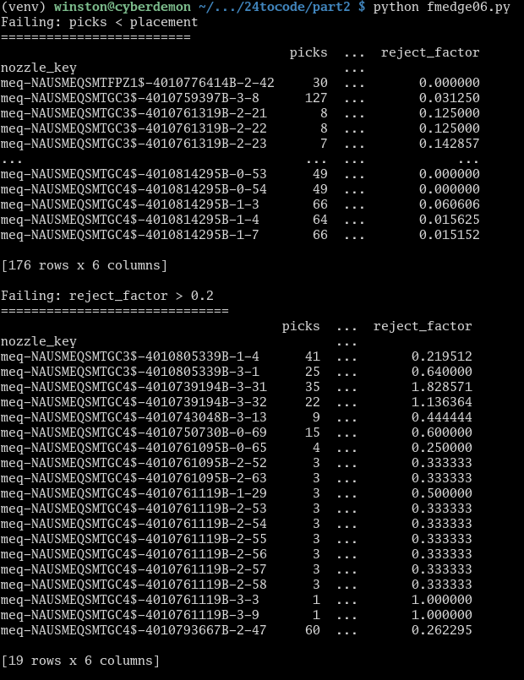
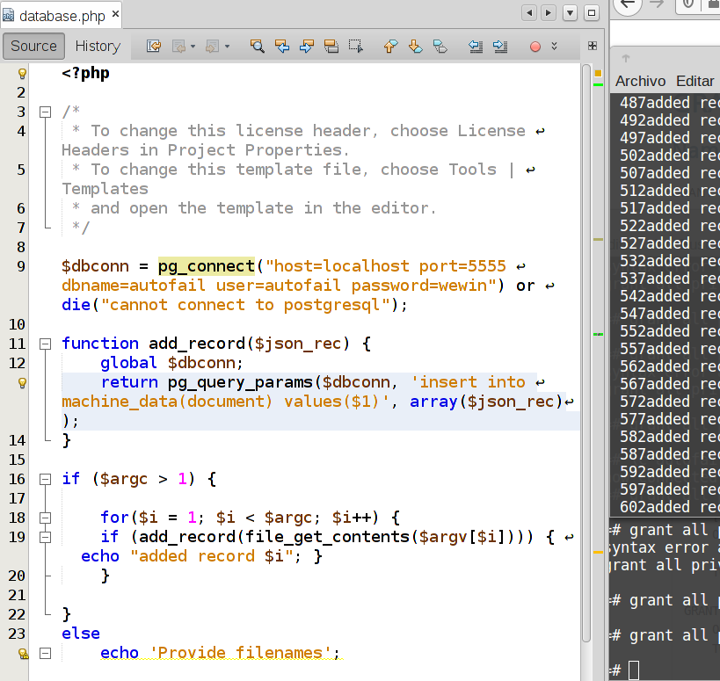
User Environment / Interface

Slide 8
What we learned
FactoryTalk Edge - pipeline / Mqtt
Data can be hard to analyze, especially when you lack knowledge of it’s source
Unix’s time_t is easy, RFC 3339 -> Pandas (python) date object is not
Using PostgreSQL as a NoSQL database (native JSON support)
Sleep is overrated (?!?!)

Slide 9
Networking Lab

